Slide 1
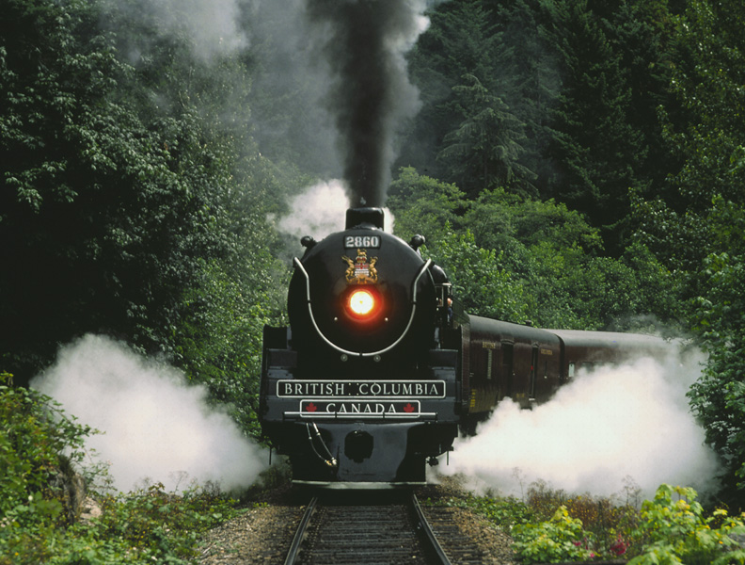
Chapter 20: Spontaneous Change:
Entropy and Free Energy
General Chemistry
Principles and Modern Applications
Petrucci • Harwood • Herring
8th Edition
Philip Dutton
University of Windsor, Canada
N9B 3P4
Prentice-Hall © 2002

Slide 2
Contents
20-1 Spontaneity: The Meaning of Spontaneous Change
20-2 The Concept of Entropy
20-3 Evaluating Entropy and Entropy Changes
20-4 Criteria for Spontaneous Change:
The Second Law of Thermodynamics
20-5 Standard Fee Energy Change, ΔG°
20-6 Free Energy Change and Equilibrium
20-7 ΔG° and K_{eq} as Functions of Temperature
20-8 Coupled Reactions
Focus On Coupled Reactions in Biological Systems

Slide 3
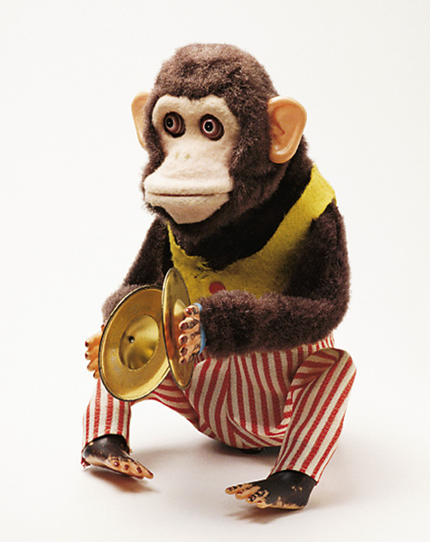
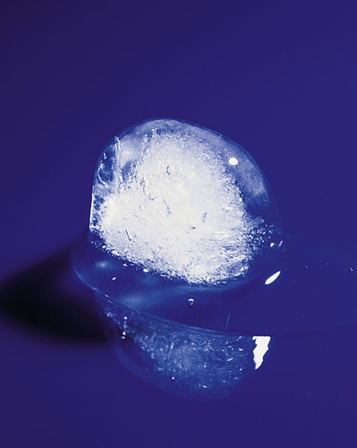
20-1 Spontaneity: The Meaning of Spontaneous Change

Slide 4
Spontaneous Process
A process that occurs in a system left to itself.
  Once started, no external actions is necessary to make the process continue.
A non-spontaneous process will not occur without external action continuously applied.
4 Fe(s) + 3 O₂(g) → 2 Fe₂O₃(s)
H₂O(s)  H₂O(l)

Slide 5
Spontaneous Process
Potential energy decreases.
For chemical systems the internal energy U is equivalent to potential energy.
Berthelot and Thomsen 1870’s
  Spontaneous change occurs in the direction in which the enthalpy of a system decreases.
  Mainly true but there are exceptions.

Slide 6
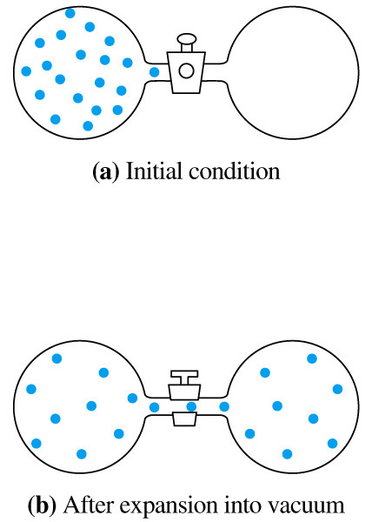
20-2 The Concept of Entropy
Entropy, S.
  The greater the number of configurations of the microscopic particles among the energy levels in a particular system, the greater the entropy of the system.
  ΔS > 0 spontaneous
ΔU = ΔH = 0

Slide 7
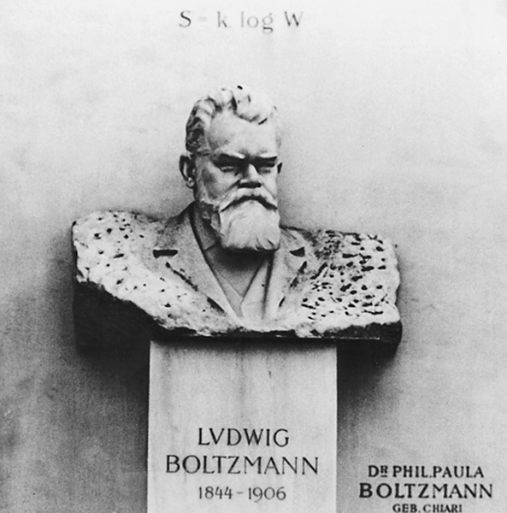
The Boltzmann Equation for Entropy
S = k lnW
States, S.
  The microscopic energy levels
  available in a system.
Microstates, W.
  The particular way in which particles are distributed amongst the states. Number of microstates = W.
The Boltzmann constant, k.
  Effectively the gas constant per molecule = R/N_{A}.
Notes:
Ludwig Boltzmann.
Associated the number of energy levels in a system with the number of ways of arranging the particles in these levels.

Slide 8
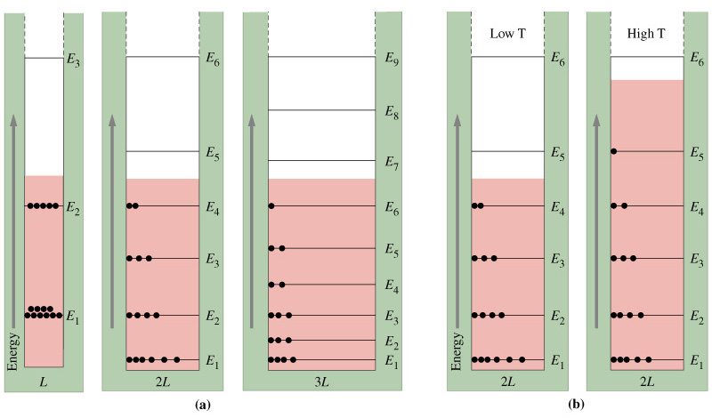
Boltzmann Distribution

Slide 9
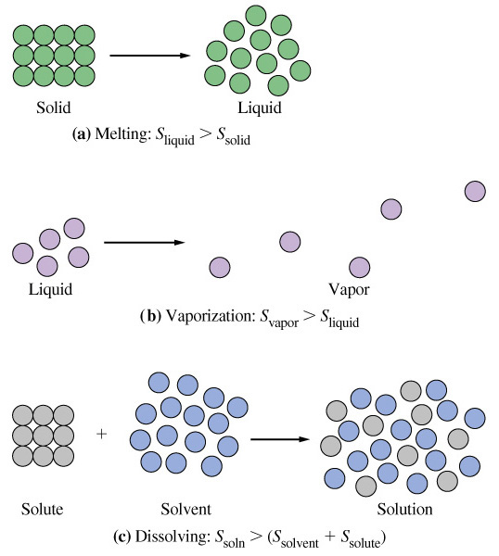
Entropy Change
q_{rev}
ΔS =
T

Slide 10
20-3 Evaluating Entropy and
Entropy Changes
Phase transitions.
  Exchange of heat can be carried out reversibly.
ΔH
ΔS =
T_{tr}
H₂O(s, 1 atm)  H₂O(l, 1 atm) ΔH_{fus}° = 6.02 kJ at 273.15 K
°
ΔH_{fus}
6.02 kJ mol⁻¹
ΔS_{fus} =
=
= 2.2010⁻² kJ mol⁻¹ K⁻¹
T_{tr}
273.15 K

Slide 11
Trouton’s Rule
ΔH_{vap}
ΔS =
 87 kJ mol⁻¹ K⁻¹
T_{bp}
Notes:
Failures of this rule are understandable:
Water and hydrogen bonding. S_{liquid} is lower than expected so ΔS is larger than 87.

Slide 12
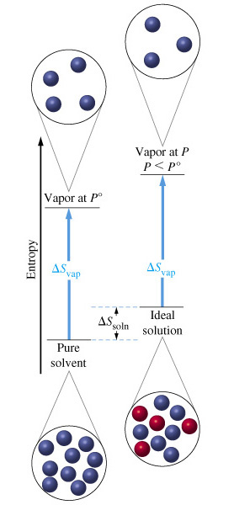
Raoult’s Law
°
P_{A} = χ _{A}P_{A}

Slide 13
Absolute Entropies
Third law of thermodynamics.
  The entropy of a pure perfect crystal at 0 K is zero.
Standard molar entropy.
  Tabulated in Appendix D.
ΔS = [ ν_{p}S°(products) - ν_{r}S°(reactants)]
Notes:
ν are the stoichiometric coefficients.

Slide 14
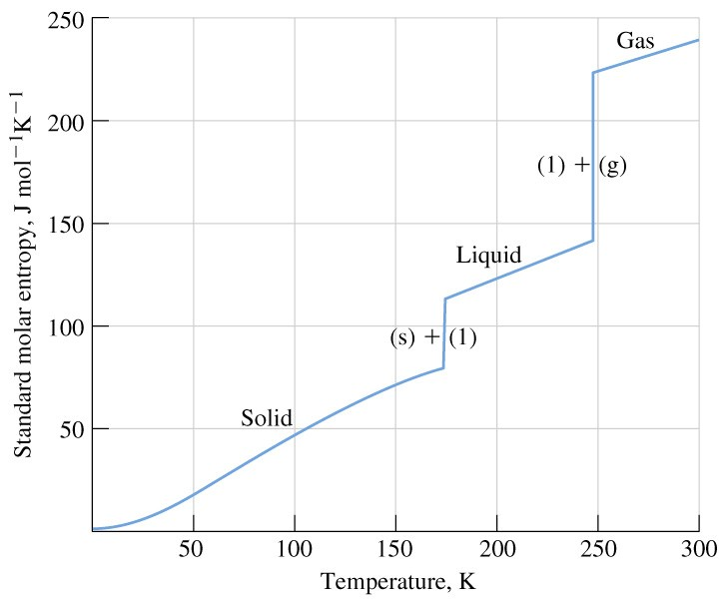
Entropy as a Function of Temperature

Slide 15
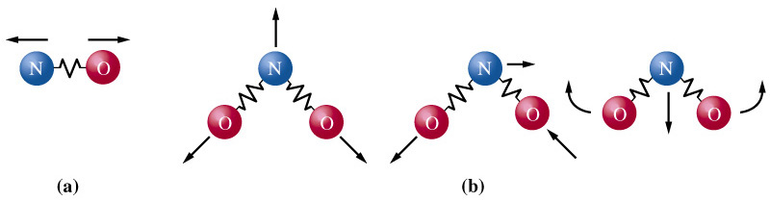
Vibrational Energy and Entropy

Slide 16
20-4 Criteria for Spontaneous Change:
The Second Law of Thermodynamics.
ΔS_{total} = ΔS_{universe} = ΔS_{system} + ΔS_{surroundings}
The Second Law of Thermodynamics:
ΔS_{universe} = ΔS_{system} + ΔS_{surroundings} > 0
All spontaneous processes produce an
increase in the entropy of the universe.

Slide 17
Free Energy and Free Energy Change
Hypothetical process:
  only pressure-volume work, at constant T and P.
q_{surroundings} = -q_{p} = -ΔH_{sys}
Make the enthalpy change reversible.
  large surroundings, infinitesimal change in temperature.
Under these conditions we can calculate entropy.
Notes:
Want to evaluate the system only, not the surroundings.

Slide 18
Free Energy and Free Energy Change
For the universe:
TΔS_{univ.} = TΔS_{sys} – ΔH_{sys} = -(ΔH_{sys} – TΔS_{sys})
-TΔS_{univ.} = ΔH_{sys} – TΔS_{sys}
For the system:
G = H - TS
ΔG = ΔH - TΔS
ΔG_{sys} = - TΔS_{universe}

Slide 19
Criteria for Spontaneous Change
ΔG_{sys} < 0 (negative), the process is spontaneous.
ΔG_{sys} = 0 (zero), the process is at equilibrium.
ΔG_{sys} > 0 (positive), the process is non-spontaneous.

Slide 20
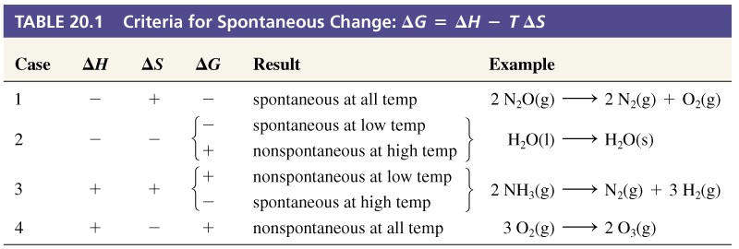
Table 20.1 Criteria for Spontaneous Change

Slide 21
20-5 Standard Free Energy Change, ΔG°
The standard free energy of formation, ΔG_{f}°.
  The free energy change for a reaction in which a substance in its standard state is formed from its elements in reference forms in their standard states.
The standard free energy of reaction, ΔG°.
ΔG° = [ ν_{p} ΔG_{f}°(products) - ν_{r} ΔG_{f}°(reactants)]

Slide 22
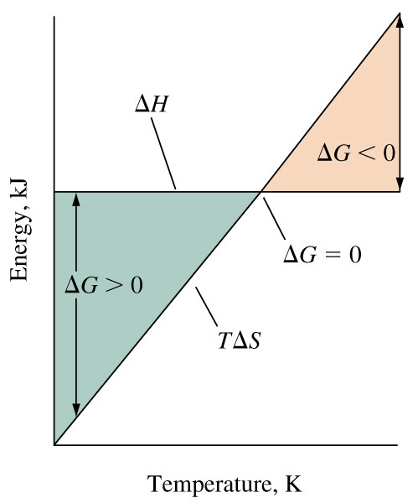
20-6 Free Energy Change and Equilibrium

Slide 23
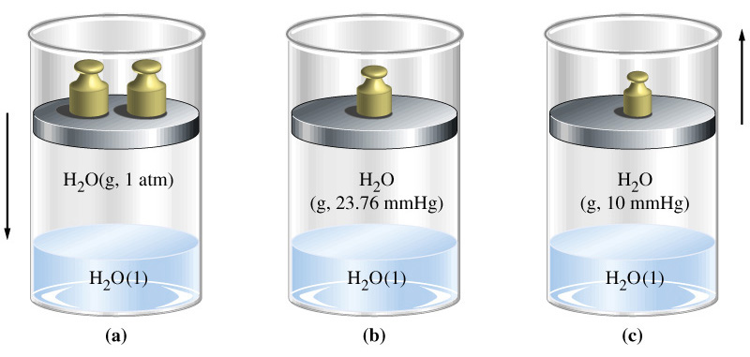
Free Energy Change and Equilibrium

Slide 24
Relationship of ΔG° to ΔG for
Nonstandard Conditions
2 N₂(g) + 3 H₂(g)  2 NH₃(g)
ΔG = ΔH - TΔS
ΔG° = ΔH° - TΔS°
For ideal gases ΔH = ΔH°
ΔG = ΔH° - TΔS

Slide 25
Relationship Between S and S°
V_{f}
q_{rev} = -w = RT ln
V_{i}
q_{rev}
V_{f}
ΔS =
= R ln
T
V_{i}
V_{f}
P_{i}
P_{f}
ΔS = S_{f} – S_{i}
= R ln
= R ln
= -R ln
V_{i}
P_{f}
P_{i}
P
P
S = S°
- R ln
= S°
- R ln
= S° - R ln P
P°
1

Slide 26
2 N₂(g) + 3 H₂(g)  2 NH₃(g)
S_{N2} =
S_{N2} – Rln P_{N2}
S_{H2} =
S_{H2} – Rln P_{H2}
S_{NH3} =
S_{NH3} – Rln P_{NH3}
ΔS_{rxn} = 2(S_{NH3} – Rln P_{NH3}) – 2(S_{N2} – Rln P_{N2}) –3(S_{H2} – Rln P_{H2})
2
3
P_{N2}P_{H2}
ΔS_{rxn} = 2 S_{NH3} – 2S_{N2} –3S_{H2}+ Rln
2
P_{NH3}
2
3
P_{N2}P_{H2}
ΔS_{rxn} = ΔS°_{rxn} + Rln
2
P_{NH3}

Slide 27
ΔG Under Non-standard Conditions
2
3
P_{N2}P_{H2}
ΔG = ΔH° - TΔS
ΔS_{rxn} = ΔS°_{rxn} + Rln
2
P_{NH3}
2
3
P_{N2}P_{H2}
ΔG = ΔH° - TΔS°_{rxn} – TR ln
2
P_{NH3}
2
P_{NH3}
ΔG = ΔG° + RT ln
2
3
P_{N2}P_{H2}
ΔG = ΔG° + RT ln Q

Slide 28
ΔG and the Equilibrium Constant K_{eq}
ΔG = ΔG° + RT ln Q
If the reaction is at equilibrium then:
ΔG = ΔG° + RT ln K_{eq}= 0
ΔG° = -RT ln K_{eq}

Slide 29
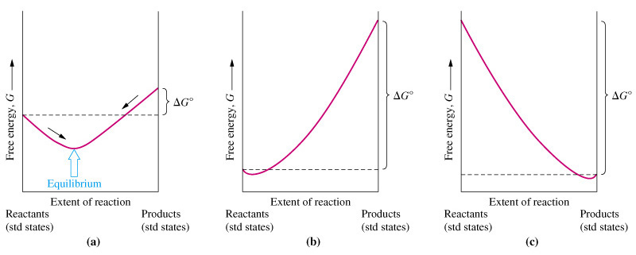
Criteria for Spontaneous Change
Every chemical reaction consists of both a
forward and a reverse reaction.
The direction of spontaneous change is the direction
in which the free energy decreases.

Slide 30
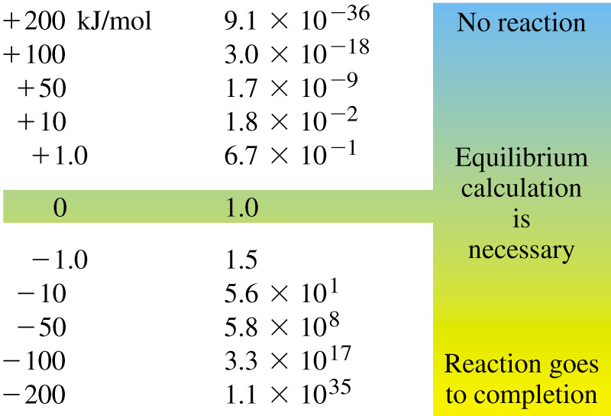
Significance of the Magnitude of ΔG

Slide 31
The Thermodynamic Equilibrium Constant: Activities
For ideal gases at 1.0 bar:
P
P
S = S°
- R ln
= S°
- R ln
P°
1
PV=nRT or P=(n/V)RT, pressure is an effective concentration
Therefore, in solution:
c
S = S°
- R ln
= S°
- R ln a
c°
The effective concentration in the standard
state for an ideal solution is c° = 1 M.
Notes:
Activity is the effective concentration divided by the effective concentration in the standard state.

Slide 32
Activities
For pure solids and liquids:
        a = 1
For ideal gases:
        a = P (in bars, 1 bar = 0.987 atm)
For ideal solutes in aqueous solution:
        a = c (in mol L⁻¹)

Slide 33
The Thermodynamic Equilibrium Constant, K_{eq}
A dimensionless equilibrium constant expressed in terms of activities.
Often K_{eq} = K_{c}
Must be used to determine ΔG.
a_{g}a_{h}…
ΔG = ΔG° + RT ln
a_{a}a_{b}…

Slide 34
20-7 ΔG° and K_{eq} as Functions of Temperature
ΔG° = ΔH° -TΔS°
ΔG° = -RT ln K_{eq}
-ΔG°
-ΔH°
TΔS°
ln K_{eq} =
=
+
RT
RT
RT
-ΔH°
ΔS°
ln K_{eq} =
+
RT
R
K_{eq2}
-ΔH°
ΔS°
-ΔH°
ΔS°
-ΔH°
1
1
ln =
+
-
+
=
-
K_{eq1}
RT₂
R
RT₁
R
R
T₂
T₁

Slide 35
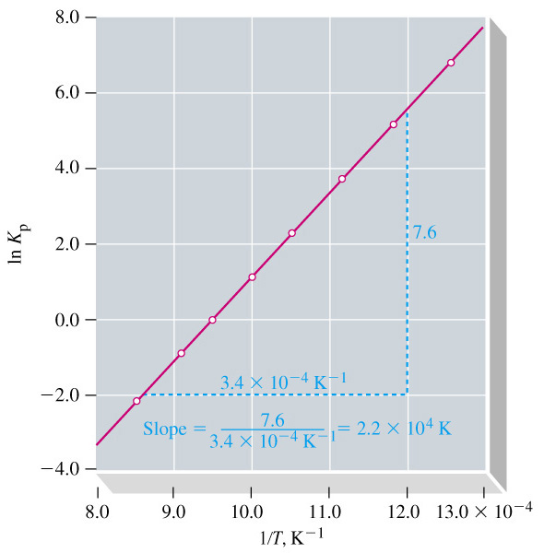
Temperature Dependence of K_{eq}
-ΔH°
ΔS°
ln K_{eq} =
+
RT
R
-ΔH°
slope =
R
-ΔH° = R  slope
= -8.3145 J mol⁻¹ K⁻¹  2.210⁴ K
= -1.810² kJ mol⁻¹

Slide 36
20-8 Coupled Reactions
In order to drive a non-spontaneous reactions we changed the conditions (i.e. temperature or electrolysis)
Another method is to couple two reactions.
  One with a positive ΔG and one with a negative ΔG.
  Overall spontaneous process.

Slide 37
Smelting Copper Ore
Δ
Cu₂O(s) → 2 Cu(s) + ½ O₂(g) ΔG°_{673K} = +125 kJ
Non-spontaneous reaction:
Cu₂O(s) → 2 Cu(s) + ½ O₂(g)
+125 kJ
Spontaneous reaction:
C(s) + ½ O₂(g) → CO(g)
-175 kJ
Cu₂O(s) + C(s) → 2 Cu(s) + CO(g)
-50 kJ
Spontaneous reaction!

Slide 38
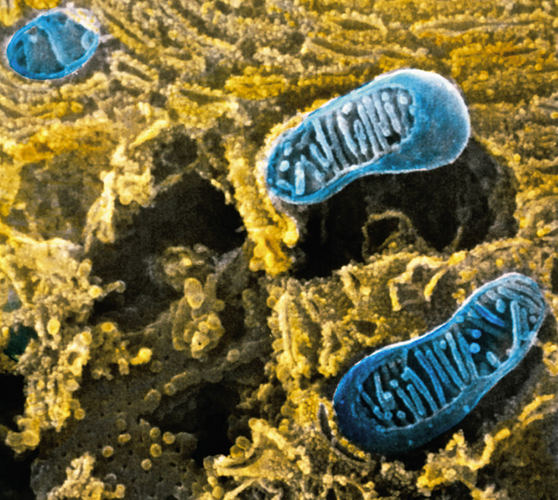
Focus On Coupled Reactions in
Biological Systems
ADP³⁻ + HPO₄²⁻ + H⁺ → ATP⁴⁻ + H₂O
ΔG° = -9.2 kJ mol⁻¹
a_{ATP}a_{H2O}
ΔG = ΔG° + RT ln
a_{ADP}a_{Pi}a_{H3O}+
But [H₃O⁺] = 10⁻⁷ M not 1.0 M.
ΔG = -9.2 kJ mol⁻¹ + 41.6 kJ mol⁻¹
= +32.4 kJ mol⁻¹ = ΔG°'
The biological standard state:

Slide 39
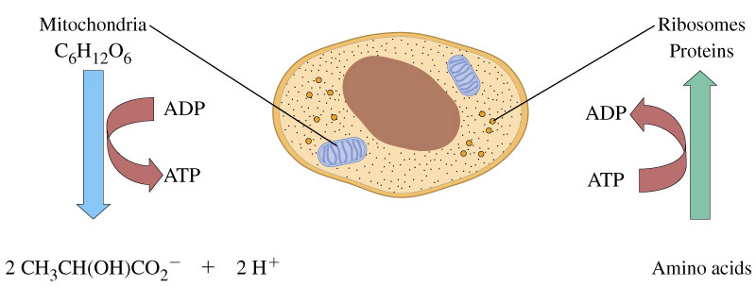
Focus On Coupled Reactions in
Biological Systems
Glucose → 2 lactate + 2 H⁺
-218 kJ
2 ADP³⁻ + 2 HPO₄²⁻ + 2 H⁺ → 2 ATP⁴⁻ + 2 H₂O
+64 kJ
2 ADP³⁻ + 2 HPO₄²⁻ + glucose → 2 ATP⁴⁻ + 2 H₂O + 2 lactate
-153 kJ

Slide 40
Chapter 20 Questions
Develop problem solving skills and base your strategy not on solutions to specific problems but on understanding.
Choose a variety of problems from the text as examples.
Practice good techniques and get coaching from people who have been here before.

